Slide 1
Using CLion with SFML
Christian Auby

Slide 2
About SFML
SFML is a cross platform multimedia library for C++
It’s often used to make games
SFML handles platform specifics for you:
Creating and configuring windows
Drawing to the screen
Mouse keyboard / input
Etc.
No need for additional libraries

Slide 3
Linux (Ubuntu/Debian) installation
Install libraries from the terminal: sudo apt-get install libsfml-dev
CMakeLists.txt configuration (last slide)

Slide 4
Mac OS X
Install brew from the terminal
Install libraries from the terminal using brew: brew install sfml
Add library paths (second to last slide)
CMakeLists.txt configuration (last slide)

Slide 5
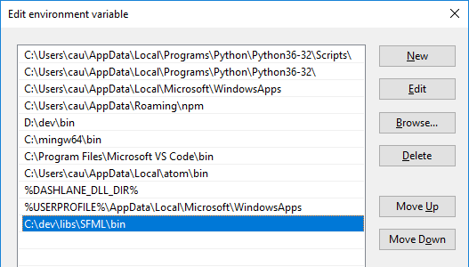
Windows installation (MinGW compiler)
Download SFML MinGW 64bit development libraries from sfml-dev.org GCC 7.3.0 MinGW (SEH) - 64-bit is for the compiler we have installed.
Unpack SFML to e.g. C:\dev\libs. Rename the folder to SFML so that it doesn’t contain the version number. This makes it easier to upgrade SFML later on.
Add C:\dev\libs\SFML\bin path (from step 2) to the end of the Windows path: Advanced System Settings* -> Environment Variables -> PATH under User variables. Edit the existing Path variable.
Restart CLion (IMPORTANT)
Add library paths (second to last slide)
CMakeLists.txt configuration (last slide)
Notes:
When downloading a prebuilt library it must be for the same compiler you are using.
If you are getting linker errors on Windows it might be because your version of GCC / MinGW doesn’t match the requirement from SFML.
* Norsk: Avanserte Systeminnstillinger -> Miljøvariabler -> Path (rediger)

Slide 6
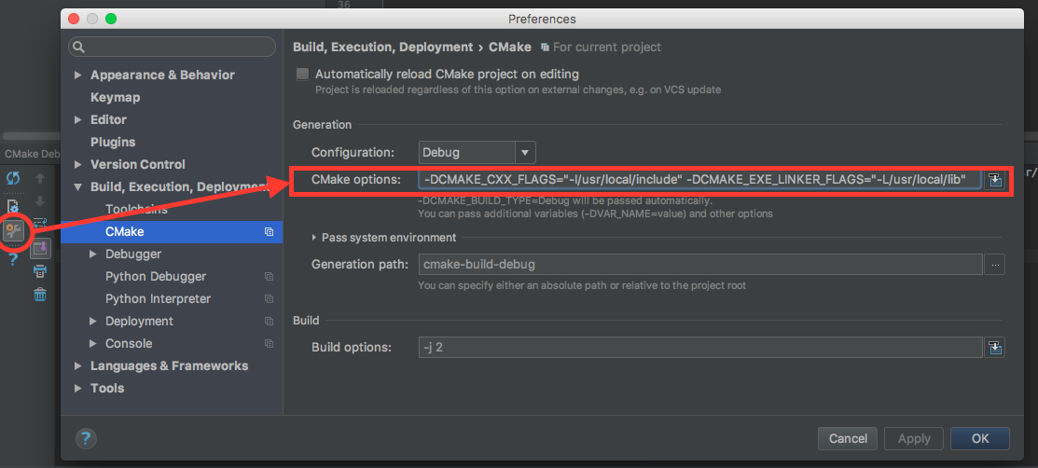
Windows / OSX: Adding libraries to CLion
On Windows and OSX you need to add the library locations to CLion
First open the CMake configuration: View -> Tool Windows -> CMake
Click the cog with an error on the bottom left, then CMake Settings
Then add the following settings, edit paths as necessary (no spaces):
Windows (replace C: with D: if your libs are on D:, use forward /): -DCMAKE_CXX_FLAGS="-IC:/dev/libs/SFML/include" -DCMAKE_EXE_LINKER_FLAGS="-LC:/dev/libs/SFML/lib"
OSX: -DCMAKE_CXX_FLAGS="-I/usr/local/include" -DCMAKE_EXE_LINKER_FLAGS="-L/usr/local/lib"
Notes:
Note: If you are adding multiple libraries (SFML + JsonCpp for example) on Windows you still only set each variable once, but with multiple paths:
-DCMAKE_CXX_FLAGS="-IC:/dev/libs/SFML/include -IC:/dev/libs/jsoncpp/include" -DCMAKE_EXE_LINKER_FLAGS="-LC:/dev/libs/SFML/lib -LC:/dev/libs/jsoncpp/lib"

Slide 7
CMakeLists.txt configuration
You add libraries to your binary using target_link_libraries
The SFML libraries required are the same for all platforms
Try my SFML example on Git to check your setup
target_link_libraries (example sfml-graphics sfml-window sfml-system)

Slide 8
Testing to see if it works
You can test your setup using the 2D example from the documentation:
https://www.sfml-dev.org/tutorials/2.5/graphics-draw.php

